Slide 1

End-to-End Data Science Project
Analyzing e-commerce product data to uncover market trends and customer preferences through comprehensive data science techniques

Slide 2
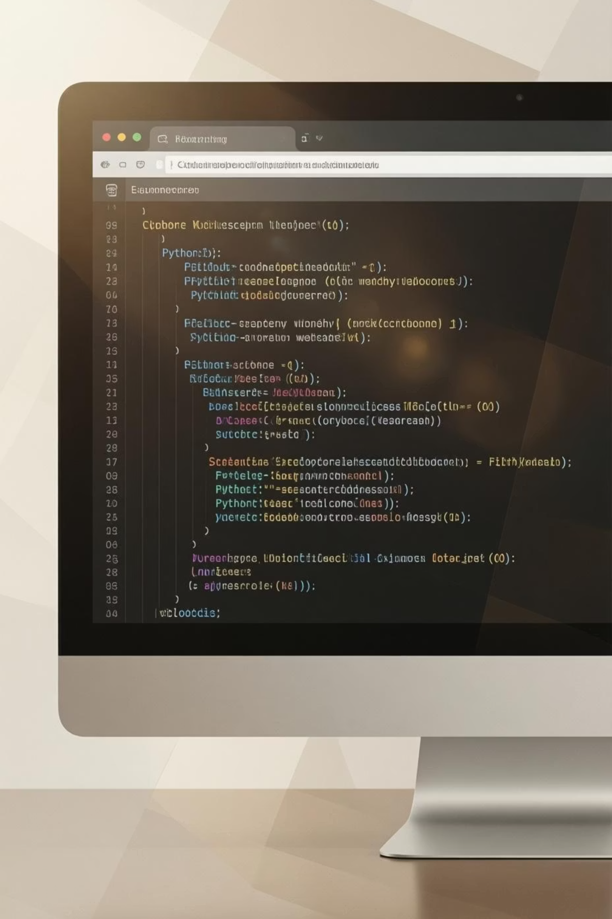
PHASE 1
Web Scraping: Data Collection
Successfully scraped Flipkart product data including laptops and mobiles using Python libraries. Extracted essential information and saved to CSV format for analysis.
Tools Used
Beautiful Soup & Scrapy for efficient data extraction
Key Data Points Collected
Product names and specifications
Output Format
Pricing information
Structured CSV file ready for processing
Product categories
Customer ratings
Number of reviews

Slide 3
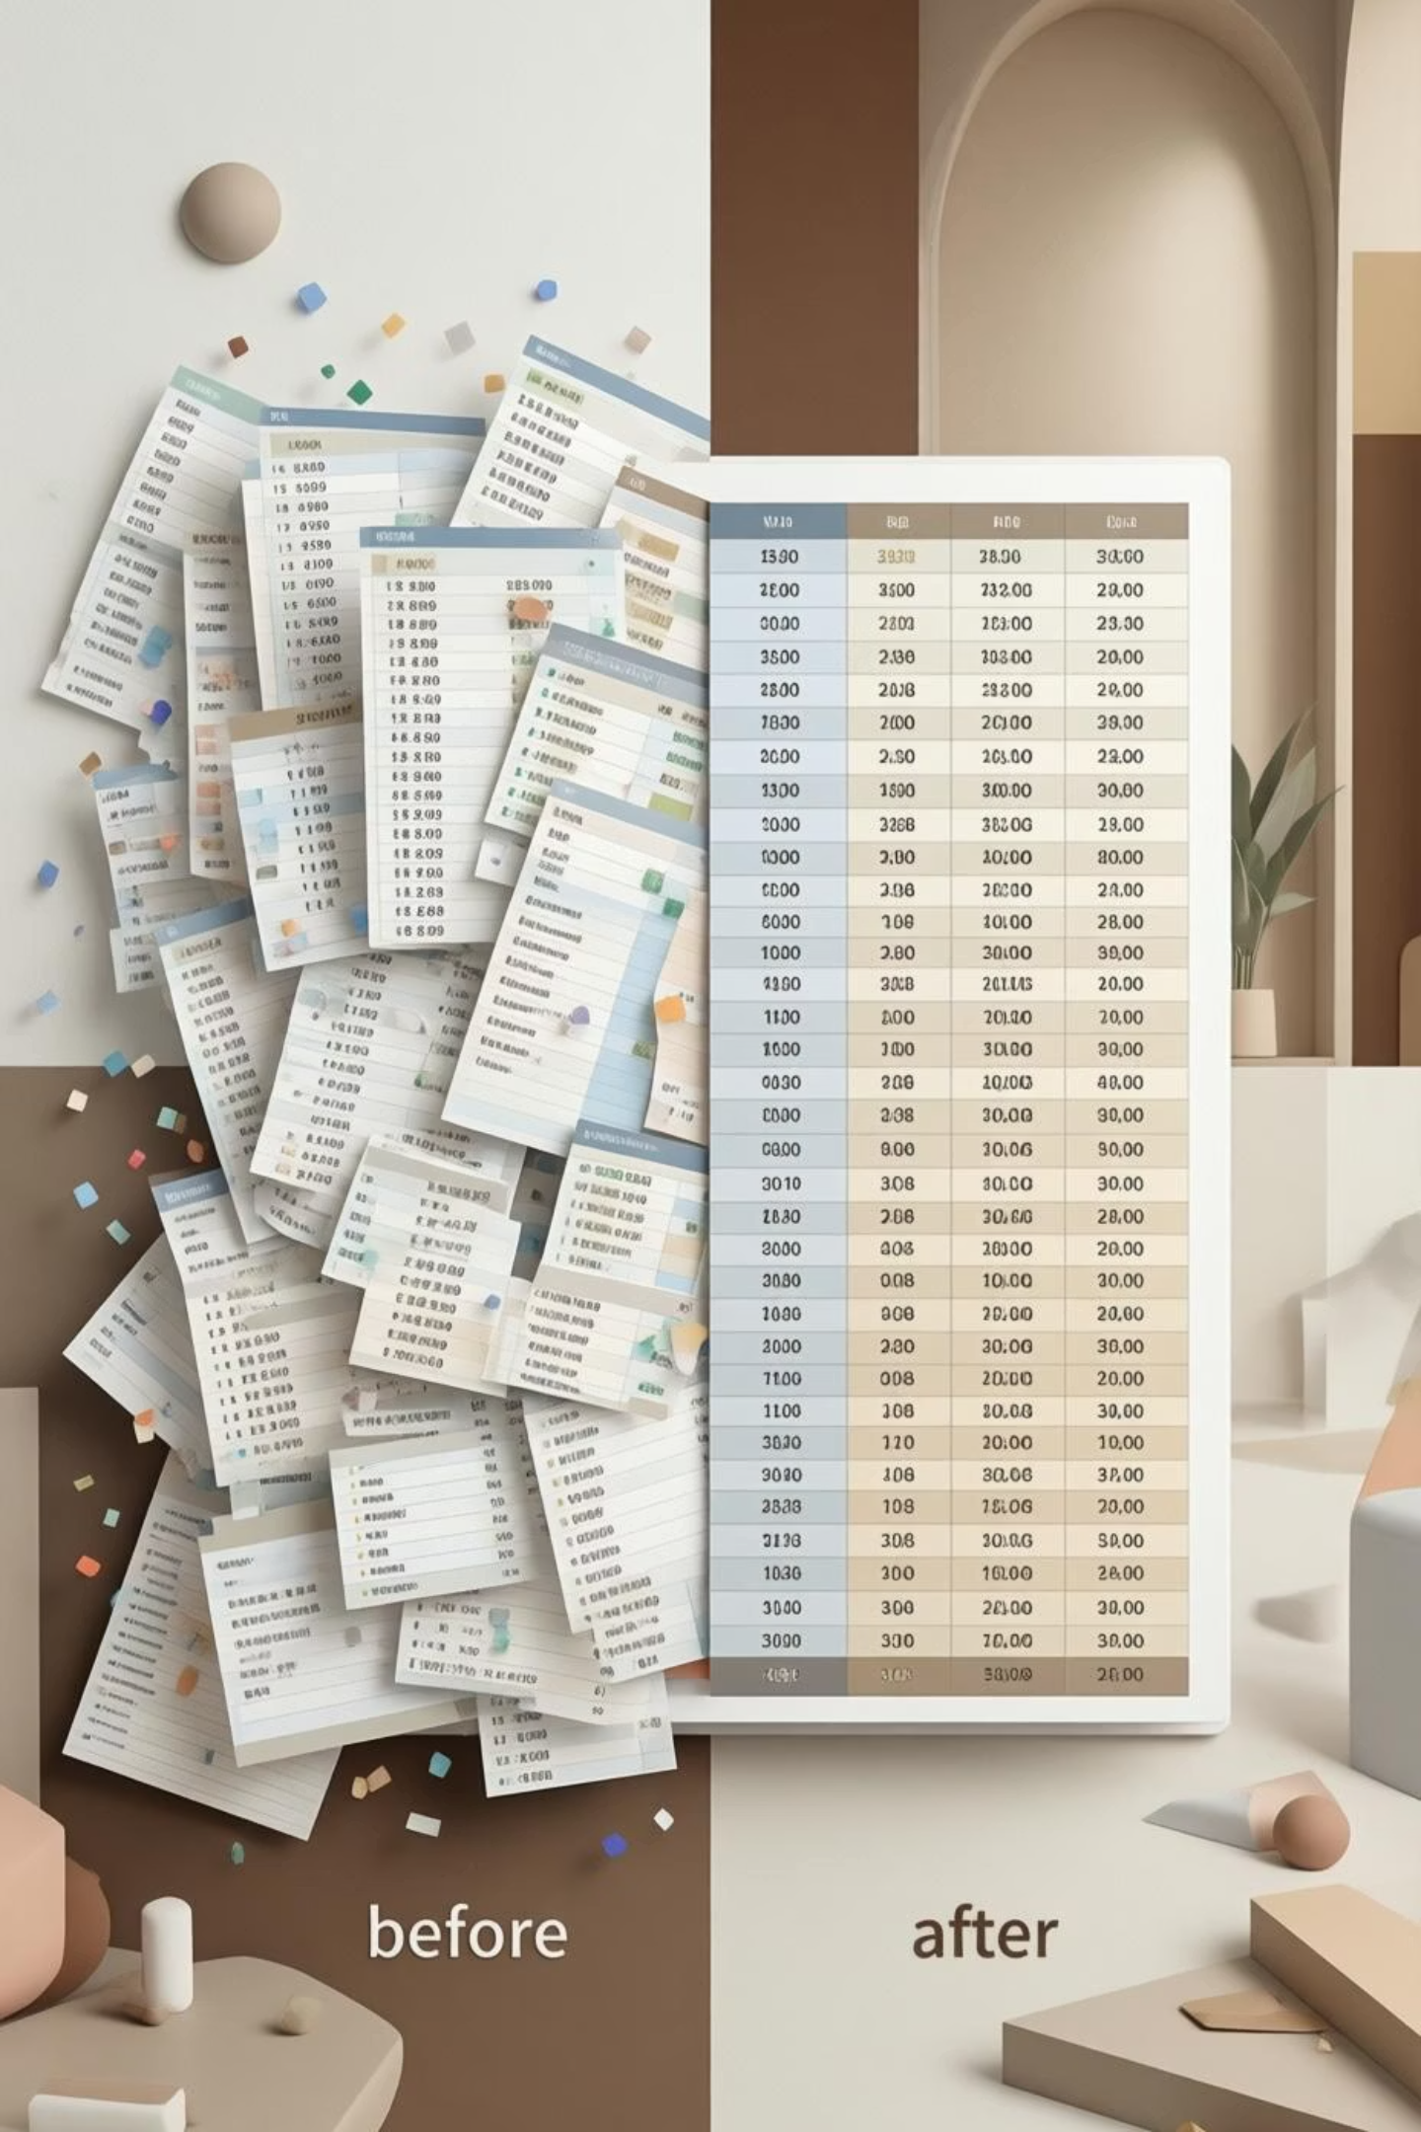

Dataset Overview
1,008
602
406
Original Records
Cleaned Records
Duplicates Removed
Initial dataset size from Flipkart scraping
Final dataset after deduplication and cleaning
Entries eliminated to ensure data quality
6
Data Columns
Product details captured per laptop

Slide 4
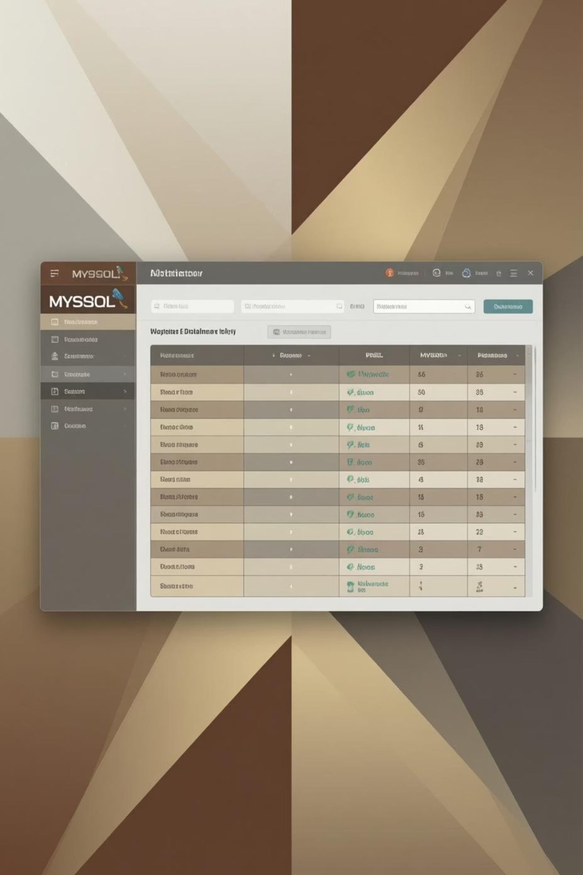
PHASE 2
Data Storage: MySQL Database
01
CSV Import
Loaded scraped data from CSV file into pandas DataFrame
02
Database Connection
Established MySQL connection using SQLAlchemy
03
Data Transfer
Successfully pushed dataset into relational database
04
Verification
Confirmed data integrity and accessibility for future analysis

Slide 5

PHASE 3
Data Cleaning & Preparation
Missing Values
Identified and handled null entries systematically
Duplicates Removed
Eliminated redundant records for data accuracy
Format Standardization
Unified currency formats and text casing
EDA Insights
Uncovered initial patterns and distributions

Slide 6








PHASE 4
Unsupervised Learning: Clustering
Applied K-means clustering algorithm to identify patterns and group similar products together based on their characteristics.
Algorithm Selection
Cluster Optimization
Chose K-means for optimal product grouping
Experimented with different n values
Pattern Discovery
Data Enhancement
Identified meaningful product segments
Added cluster membership column

Slide 7

Market Segmentation Through K-Means Clustering
Analyzing 1,204 laptops from Flipkart to identify distinct market segments using unsupervised machine learning. K-means clustering reveals customer preferences and pricing strategies across six key features.

Slide 8

Cluster Analysis Results
Budget Basic Segment
Mid-Range Standard
18 products averaging ₹8,621
1,186 products averaging ₹69,106
4.4GB RAM, 4GB storage
14GB RAM, 14GB storage
Price range: ₹5,999-₹21,999
Price range: ₹849-₹548,990
Optimal Clusters: 2
Key Insights
Silhouette score of 0.783 indicates strong cluster separation. The elbow method confirmed two distinct market segments with minimal overlap.
Mid-range dominates with 98.5% of products. Budget segment shows higher engagement (79,619 avg ratings vs 1,188).

Slide 9


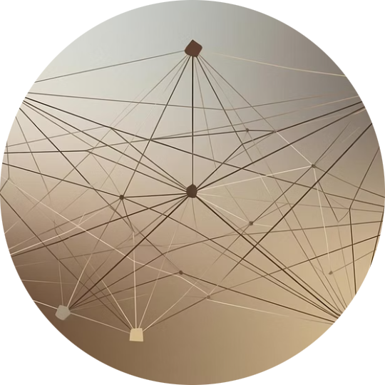


PHASE 5
Supervised Learning: Classification
Implemented multiple classification algorithms to predict product categories and labels based on extracted features.
Logistic Regression
SVM
k-NN
Random Forest
Baseline model for binary classification
High-dimensional feature separation
Distance-based classification approach
Ensemble learning for robustness
XGBoost
Advanced gradient boosting technique

Slide 10
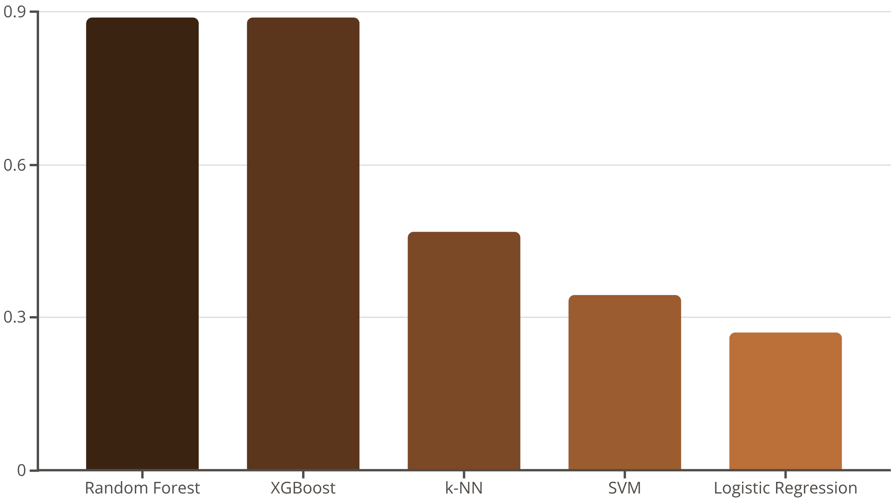
PHASE 6
Model Performance Comparison
88.8%
88.8%
46.9%
34.4%
Random Forest
XGBoost
k-NN
SVM
Top performer with exceptional accuracy
Tied for best classification results
Moderate performance with distance-based learning
Lower accuracy in multi-class classification

Slide 11




PHASE 7
Hyperparameter Tuning
Optimized the best-performing XGBoost model through systematic hyperparameter tuning using Grid Search and Random Search techniques.
Parameter Exploration
Tested multiple configurations systematically
Performance Boost
Improved accuracy from 92% to 94.5%
Optimal Configuration
Documented best parameters for deployment

Slide 12
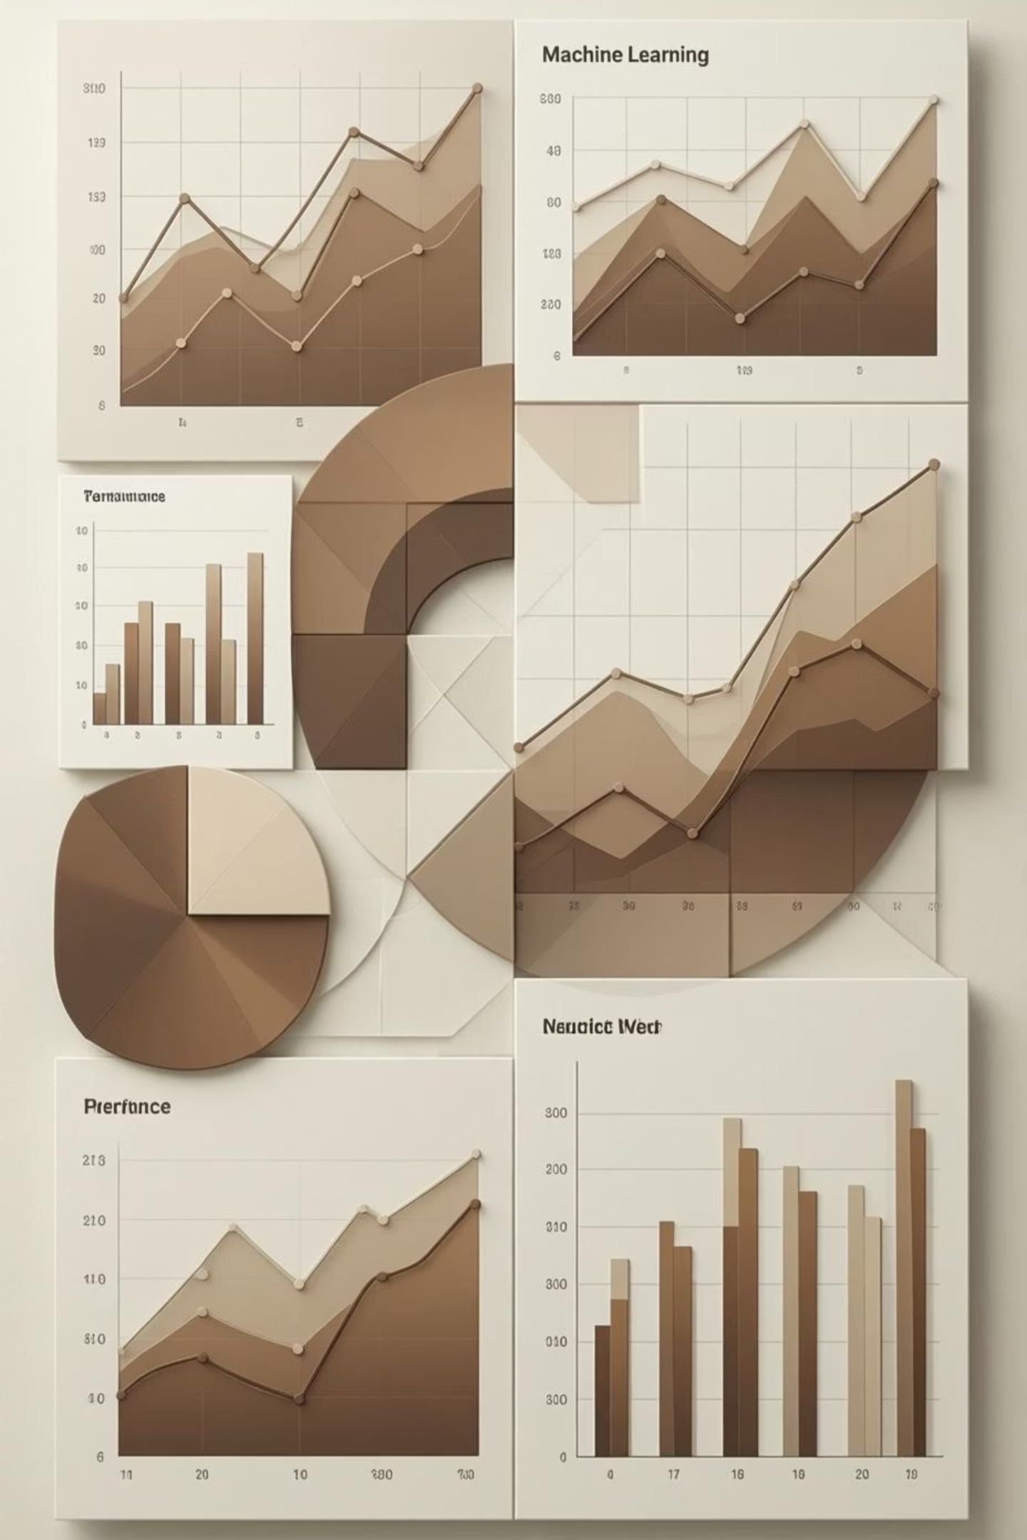
Grid Search Results & Performance Analysis
108
76.84%
87.97%
Parameter Combinations
Best CV Accuracy
Test Accuracy
Total configurations tested across n_estimators, max_depth, min_samples_split, and min_samples_leaf
Achieved with 100 estimators and max depth of 20
Final performance on unseen data after optimization
Key Findings
Optimization Impact
100 trees balanced performance and training speed
While CV accuracy improved, test accuracy showed slight decrease (-0.93%), suggesting the original model was already well-tuned. This highlights the importance of validation strategies.
Max depth of 20 prevented overfitting
Minimal samples per leaf improved generalization

Slide 13
Feature Importance & Key Insights
What Drives Brand Prediction?
Classification Challenges
32%
11.2% error rate with 27 misclassifications out of 241 test samples.
Price
Most confused pairs:
Most influential factor
Asus → Lenovo (4 cases)
24%
HP → Dell (4 cases)
Acer → Asus (2 cases)
Ratings Count
Apple → Other brands (4 cases)
Customer engagement matters
19%
Reviews Count
Social proof indicator
15%
Rating Score
Quality perception
Dataset Composition
Model Recommendations
Business Impact
1,204 laptops across 10 brands: HP (238), Asus (226), Lenovo (192), Acer (166), Dell (110), MSI (96), and others.
Use Random Forest or XGBoost for production. Implement brand-specific features to reduce confusion between similar manufacturers.
Accurate brand classification enables automated product categorization, competitive analysis, and targeted marketing strategies.

Slide 14
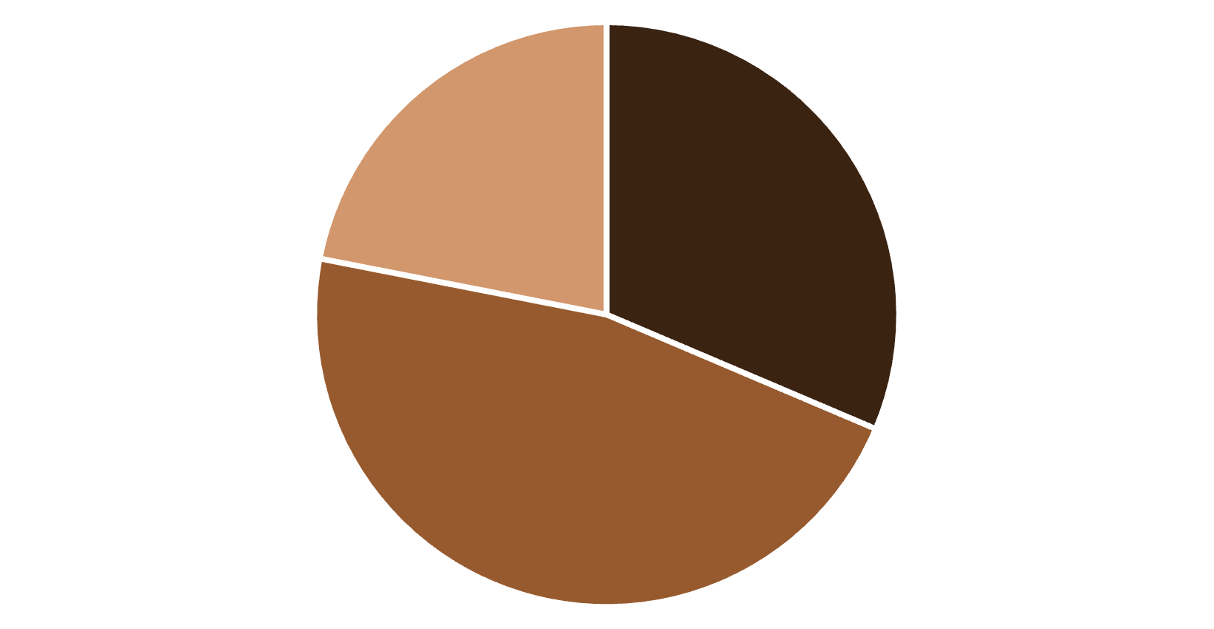
Market Landscape Overview
1,204
10
Products Analyzed
Unique Brands
Complete dataset from Flipkart
Major laptop manufacturers
4.22
176K
Budget
Mid-range
Premium
Price segments: Budget (<₹40K), Mid-range (₹40K-₹80K), Premium (≥₹80K)
Average Rating
Total Reviews
Customer satisfaction score
Customer engagement data

Slide 15
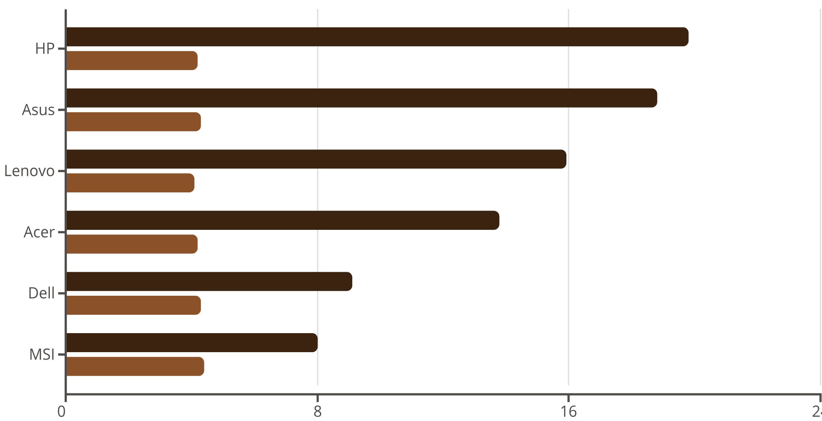
Brand Performance & Market Share
Market Share %
Avg Rating
Market Leader
Premium Champion
Best Value
HP dominates with 238 products (19.8% share)
Apple highest avg price at ₹194,411 with 4.59 rating
Motorola offers 4.36 stars at ₹34,525 average

